Slide 1
Cloud Compute with AWS
Notes:
https://courses.cs.washington.edu/courses/cse403/13au/lectures/git.ppt.pdf
http://enos.itcollege.ee/~jpoial/allalaadimised/git/getting-started-with-git.pdf

Slide 2
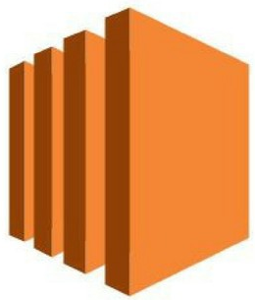
Amazon EC2 (Elastic Cloud Compute) Overview
Provides compute capacity in the AWS cloud
EC2 instances can be resized and the number of instances scaled up or down as per our requirement
Eliminates your need to invest in hardware up front, so you can develop and deploy applications faster.

Slide 3
Hands-On:
Launching an EC2 Instance running Linux
We’ll be launching our first virtual server using the AWS Console
We’ll get a first high level approach to the various parameters
We’ll learn how to start / stop / terminate our instance.

Slide 4
Hands-on: How to SSH into your EC2 Instance
Putty
https://winscp.net/download/putty.exe
Mobaxterm
https://download.mobatek.net/2032020060430358/MobaXterm_Portable_v20.3.zip
EC2 Instance Connect

Slide 5

Amazon AMI
As we saw, AWS comes with base images such as:
Ubuntu
Fedora
RedHat
Windows
Etc.…
These images can be customized at runtime using EC2 User data
But what if we could create our own image, ready to go?
That’s an AMI – an image to use to create our instances

Slide 6
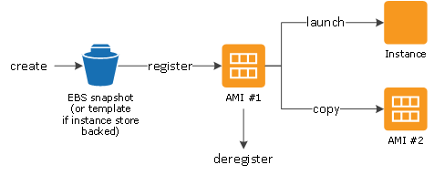
AMI Lifecycle

Slide 7
Amazon AMI
A user must specify a source AMI when setting up an instance.
Types of Machine Images
Public images
Paid images
https://aws.amazon.com/marketplace
Private images

Slide 8
Hands-on: Creating an Amazon Machine Image
A user can set up an instance using an existing Amazon Machine Image, customize it then save the updated configuration as a custom machine image.

Slide 9
Hands-on: How to Use Amazon Machine Images
After creating and registering an Amazon Machine Image, the developer can use it to set up new instances

Slide 10
Hands-on: Install AWS Command Line Interface
A command line tool for managing and administering your Amazon Web Services
Can use it to create scripts for automating your Amazon Web Services.
Installation:
sudo apt-get update
sudo apt-get install awscli
aws –version
Login to AWS Account Using AWS CLI:
aws configure
cat ~/.aws/config
cat ~/.aws/credentials
Delete to use different login credentials
rm -v ~/.aws/config ~/.aws/credentials
Help
aws help
aws ec2 help
aws s3 help

Slide 11
Hands-on: Configure AWS Command Line Interface
#Login to AWS Account Using AWS CLI:
aws configure
Specify details as below:
AWS Access Key ID [None]: <Refer to your User Credentials File>
AWS Secret Access Key [None]: < Refer to your User Credentials File >
Default region name [None]: us-east-2
Default output format [None]: json

Slide 12
Hands-on: AWS Command Line Interface
aws ec2 describe-instances
aws ec2 describe-volumes
aws s3 ls
aws iam list-users

Slide 13
Elastic IPs
When you stop and then start an EC2 instance, it can change its public IP
If you need to have a fixed public IP for your instance, you need an Elastic IP
Can be associated with an EC2 instance
The Elastic IP address remains in place even if EC2 is stopped or restarted.
You can attach it to one instance at a time
You can only have 5 Elastic IP in your account (you can ask AWS to increase that).

Slide 14
Hands-on: Private vs Public IP (IPv4) In AWS EC2
By default, your EC2 machine comes with:
A private IP for the internal AWS Network
A public IP, for the WWW.
When we are doing SSH into our EC2 machines:
We can’t use a private IP, because we are not in the same network
We can only use the public IP.
If your machine is stopped and then started, the public IP can change

Slide 15

Introduction to Security Groups
Security Groups are the fundamental of network security in AWS
They control how traffic is allowed into or out of our EC2 Machines
Acts as a virtual firewall for your EC2 instances to control incoming and outgoing traffic
Inbound rules control the incoming traffic to your instance, and
Outbound rules control the outgoing traffic from your instance

Slide 16
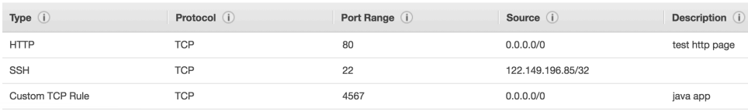
Security Groups Deeper Dive
They regulate:
Access to Ports
Authorised IP ranges – IPv4 and IPv6
Control of inbound network (from other to the instance)
Control of outbound network (from the instance to other)

Slide 17
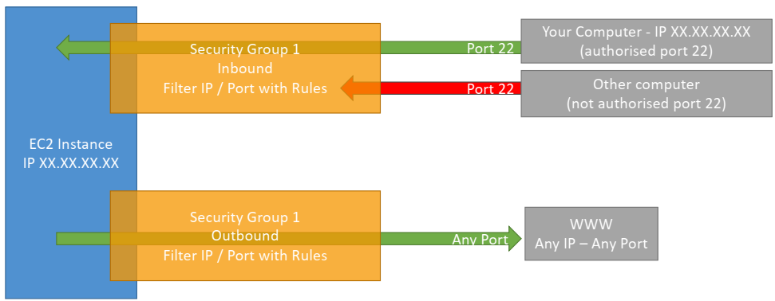
Security Group Diagram

Slide 18
Security Groups Good to know
Can be attached to multiple instances
Does live “outside” the EC2 – if traffic is blocked the EC2 instance won’t see it
If your application is not accessible (time out), then it’s a security group issue
All inbound traffic is blocked by default
All outbound traffic is authorised by default

Slide 19
Hands-on: Security Group

Slide 20
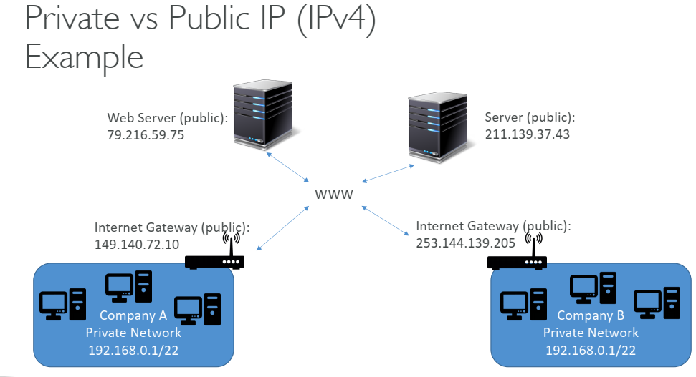
Private vs Public IP (IPv4) Example

Slide 21
EC2 User Data
It is possible to bootstrap our instances using an EC2 User data script.
Bootstrapping means launching commands when a machine starts
That script is only run once at the instance first start
EC2 user data is used to automate boot tasks such as:
Installing updates
Installing software
Downloading common files from the internet
Anything you can think of
The EC2 User Data Script runs with the root user

Slide 22
Hands-On: EC2 User Data
We want to make sure that this EC2 instance has an Apache HTTP server installed on it – to display a simple web page
For it, we are going to write a user-data script.
This script will be executed at the first boot of the instance.
For script refer:
ec2-basics.sh

Slide 23
Assignment: Install Apache Server on Ubuntu
Need to install apache server on Ubuntu using User Data script

Slide 24
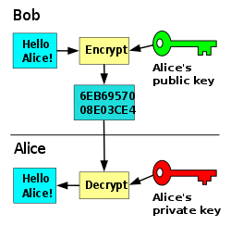
EC2 Key Pairs
A key pair consists of a private key and a public key
It is a set of security credentials
Amazon EC2 stores the public key, and you store the private key
You use the private key, instead of a password, to securely access your instances
Anyone who possesses your private keys can connect to your instances, so it's important that you store your private keys in a secure place.

Slide 25
Placement Groups
When launching a new EC2 instance, the EC2 service attempts to place the instance in such a way that all of your instances are spread out across underlying hardware to minimize correlated failures
You can use placement groups to influence the placement of a group of interdependent instances to meet the needs of your workload
Depending on the type of workload, you can create a placement group using one of the following placement strategies:
Cluster
Packs instances close together inside an Availability Zone.
To achieve the low-latency network performance
Partition
Spreads instances across logical partition
Spread
Strictly places a small group of instances across distinct underlying hardware to reduce correlated failures.

Slide 26
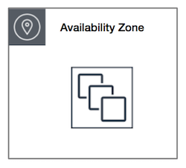
Cluster placement groups

Slide 27
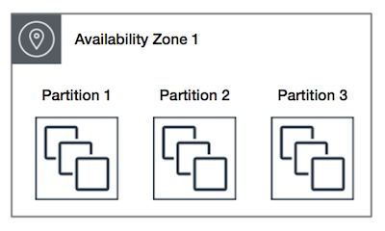
Partition placement groups

Slide 28
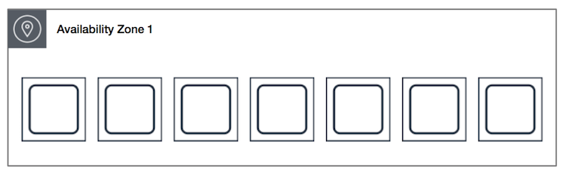
Spread placement groups

Slide 29
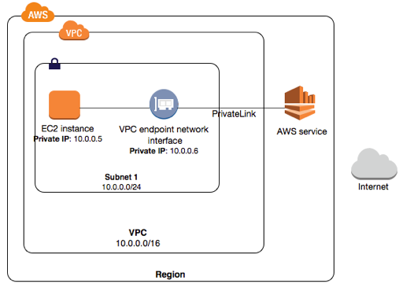
VPC (Virtual Private Cloud)
Enables to launch AWS resources into a virtual network that you've defined
This virtual network closely resembles a traditional network

Slide 30
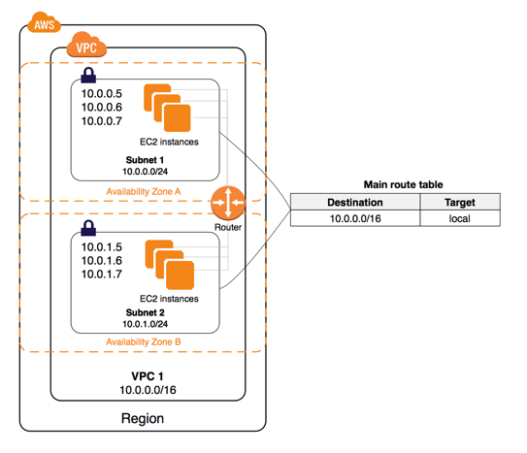
VPC (Virtual Private Cloud)

Slide 31
Hands-on: Launching EC2 instance
With Windows and
Linux OS

Slide 32
Hands-on: Attaching EBS volume
Step 1: Create a new volume of your preferred size and type.
Step 2: Select the created volume, right-click and select the “attach volume”.
Step 3: Login to ec2 instance and list available disks using:
lsblk
Step 4: Check if the volume has any data using the following command:
sudo file -s /dev/sdb
Step 5: Format volume to ext4 filesystem using the following command:
sudo mkfs -t ext4 /dev/sdb
Step 6: Mount the volume:
sudo mkdir /newvolume
sudo mount /dev/xvdf /newvolume/

Slide 33
Hands-on: Configuring Security Groups

Slide 34
Hands-on: Upgrade/downgrade EC2 instance types

Slide 35
Monitoring EC2 instance

Slide 36
Monitoring in AWS
AWS CloudWatch:
Metrics: Collect and track key metrics
Logs: Collect, monitor, analyze and store log files
Events: Send notifications when certain events happen in your AWS
Alarms: React in real-time to metrics / events
AWS X-Ray:
Troubleshooting application performance and errors
Distributed tracing of microservices
AWS CloudTrail:
Internal monitoring of API calls being made
Audit changes to AWS Resources by your users

Slide 37
Monitoring EC2 instance
An important part of maintaining the Amazon EC2 instances
Should collect monitoring data from all of the parts in your AWS solutions to easily debug a multi-point failure

Slide 38
Amazon CloudWatch
A monitoring service for AWS cloud.
To collect and track metrics, collect and monitor log files, set alarms, and automatically react to changes in your AWS resources
Can monitor AWS resources such as
Amazon EC2 instances
Amazon DynamoDB tables, and
Amazon RDS DB instances
Etc.

Slide 39
AWS CloudWatch Metrics
CloudWatch provides metrics for every services in AWS
Metric is a variable to monitor (CPUUtilization, NetworkIng)
Metrics have timestamps
Can create CloudWatch dashboards of metrics

Slide 40
AWS CloudWatch EC2 Detailed monitoring
EC2 instance metrics have metrics “every 5 minutes”
With detailed monitoring (for a cost), you get data “every 1 minute”

Slide 41
Hands-On: CloudWatch Metrics

Slide 42
AWS CloudWatch Logs
Applications can send logs to CloudWatch using the SDK
CloudWatch can collect log from:
Elastic Beanstalk: collection of logs from application
ECS: collection from containers
AWS Lambda: collection from function logs
VPC Flow Logs: VPC specific logs
API Gateway
CloudTrail based on filter
CloudWatch log agents: for example on EC2 machines
Route53: Log DNS queries
CloudWatch Logs can go to:
Batch exporter to S3 for archival
Stream to ElasticSearch cluster for further analytics

Slide 43
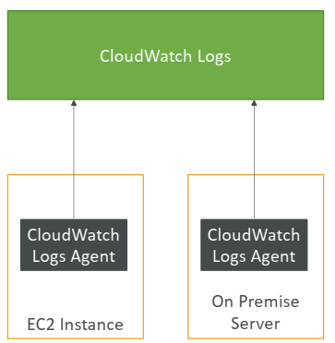
CloudWatch Logs for EC2
By default, no logs from your EC2 machine will go to CloudWatch
You need to run a CloudWatch agent on EC2 to push the log files you want
The CloudWatch log agent can be setup on-premises too

Slide 44
Assignment: Implement AWS CloudWatch Logs
Refer:
https://docs.aws.amazon.com/AmazonCloudWatch/latest/logs/QuickStartEC2Instance.html

Slide 45
Thanks

